Slide 1
Reference slides

Slide 2
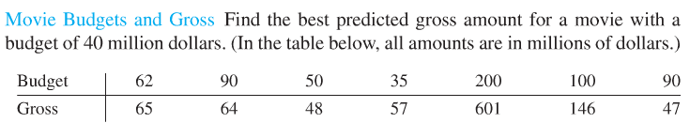
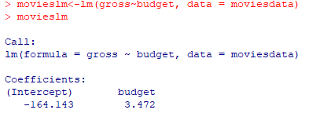
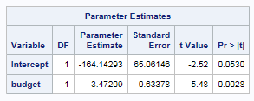

Movies: Regression equation and a predicted value of y for a given x
proc glm data = movie;
model gross = budget;
run;
OR
proc reg data= movie;
model gross = budget;
run;
Equation of Regression Line
Predicted Gross = 3.472 * Budget – 164.14
Predicted Gross for a Budget of $40 million:
$\hat{y40}$=3.472(40) – 164.14 = -$25 million!

Slide 3
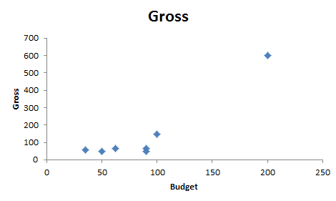
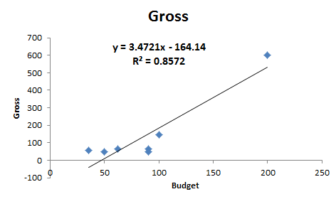



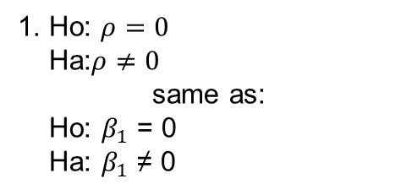
Movies: Hypothesis test for $β_{1}$
1. Ho: $ρ=0$
Ha:$ρ≠0$
same as:
Ho: $β_{1}$ = 0
Ha: $β_{1}$ ≠ 0
5. Reject Ho.
6. There is sufficient evidence at the alpha = .05 level of significance (p-value = .0028) to suggest that the data are linearly correlated (or that the slope is nonzero). We will proceed to calculate the regression line.
2. CV: $±t_{.975, 7−2=5}$ = $±$2.54
3. t = 5.48
4. p-value = .0028
t-stat = (parameter estimate – 0)/StErr
Equation of Regression Line:
Predicted Gross = – 164.14 + 3.472 * Budget
SAS

Slide 4
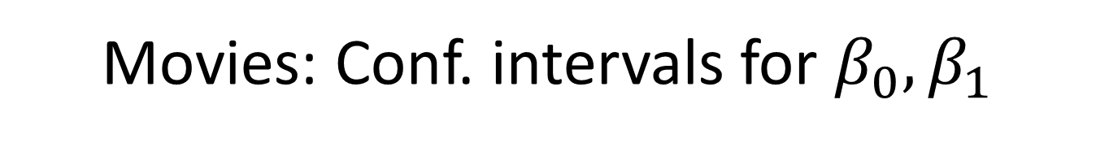
Movies: Conf. intervals for $β_{0},β_{1}$
Estimate ± t_{α/2,df}*SE
df = n-2
Estimate ± t_{α/2,df}*SE
df = n-2
Budget_slope ± t_{.025,5}*SE
Y-Intercept ± t_{.025,5}*SE
3.472 ± 2.571*.6338
-164.143 ± 2.571*65.06
(1.84, 5.10)
(-331.39,3.103)
We are 95% confident that when the budget is increased by $1 million dollars, the mean gross increases between $1.84M and $5.10M.
We are 95% confident that for a budget of $0, the mean gross is between $0M and $3.103M.

Slide 5
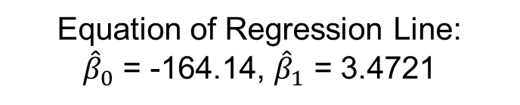
Movies: Parameter interpretation
Equation of Regression Line:
${\hat{β}}_{0}$ = -164.14, ${\hat{β}}_{1}$ = 3.4721
Pred. Gross = – 164.14 + 3.472 * Budget
Interpret the Slope:
It is estimated that for every increase in $1 million to the budget, the estimated gross will be $3.4721 million more. A 95% confidence interval is ($1.84 M, $5.10 M).
Interpret the y-intercept:
For a movie with no budget ($0), it is predicted that it will gross $0 (-$164 million from regression equation). A 95% confidence interval is ($0, $3.3 M). This has little practical meaning, which is to be expected since it is extrapolation.

